Slide 1
Singleton
Team 6

Slide 2
Group Members
15L-4213 (Wajahat)
14L-4328 (Adeel Shoukat)
15L-4033 (Usman Majied)
14L-4005 (M. Younas)
15L-4264 (Ali Nuaman)
15L-4084 (M. Adullah)

Slide 3
Classification
Purpose: Creational.
Scope: Object.

Slide 4
Intent
Ensure that a class has only one instance.
Provide a global point of access to that instance.

Slide 5
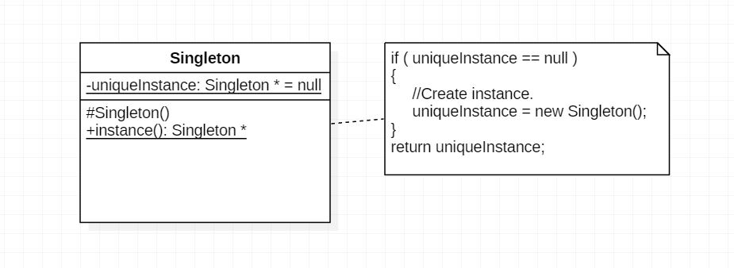
Structure

Slide 6
Implementation
Goals
Ensuring a unique instance.
Sub classing the singleton class.

Slide 7
C++ Code example
class Singleton
{
public:
static Singleton* instance();
protected:
Singleton();
private:
static Singleton* uniqueInstance;
};
Singleton * Singleton::uniqueInstance = nullptr;
Singleton * Singleton::instance()
{ if ( uniqueInstance == nullptr )
{
uniqueInstance = new Singleton();
}
return uniqueInstance;
}

Slide 8
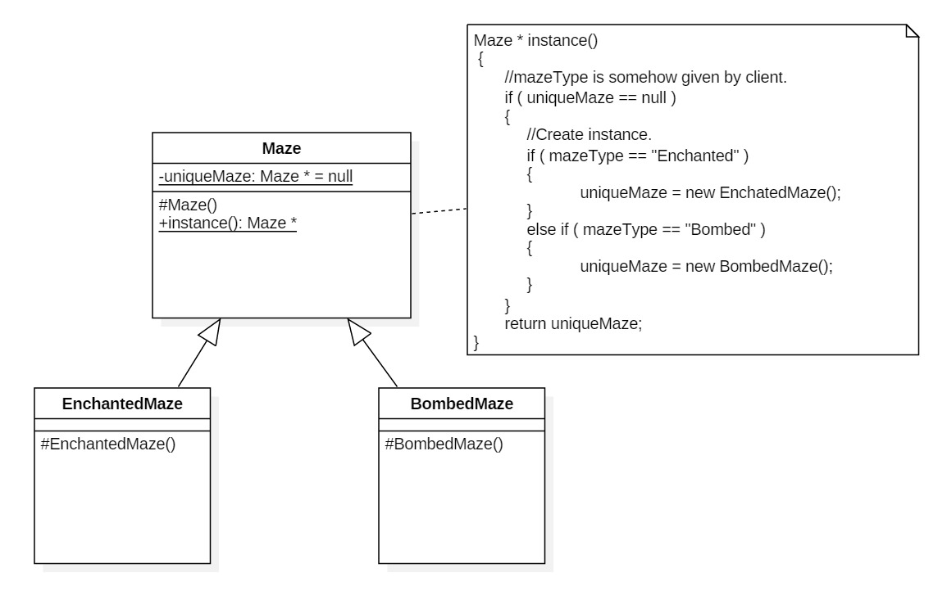
Sub-Classing and Example

Slide 9
Implementation of example in C++
Maze* Maze::instance()
{
if ( uniqueMaze == null )
{
const char* mazeStyle = getenv("MAZESTYLE");
//Conditional Ladder.
if ( strcmp(mazeStyle, "bombed") )
uniqueMaze = new BombedMaze();
else if ( strcmp(mazeStyle, "Enchanted") )
uniqueMaze = new EnchantedMaze();
//All conditions...
else
uniqueMaze = new Maze();
}
return uniqueMaze;
}
class Maze
{
public:
static Maze* instance();
protected:
Maze();
private:
static Maze* uniqueMaze;
};

Slide 10
Implementation of example in C++
class BombedMaze: public Maze
{
protected:
BombedMaze();
};
class EnchantedMaze: public Maze
{
protected:
EnchantedMaze();
};

Slide 11
Thank You!

